Slide 1
90838 林淑媛
1 hr
1 hr
30 min walk
2 hr
20 min Metro Red
30 min
30 min Metro Green
2 hr

Slide 2
Budget
Ticket | Dining | Transportation | Others
White house 15 | 150 | One-Day pass 30 | 10
Spy Museum 30
Library of Congress 5
 |  | Total | 240

Slide 3
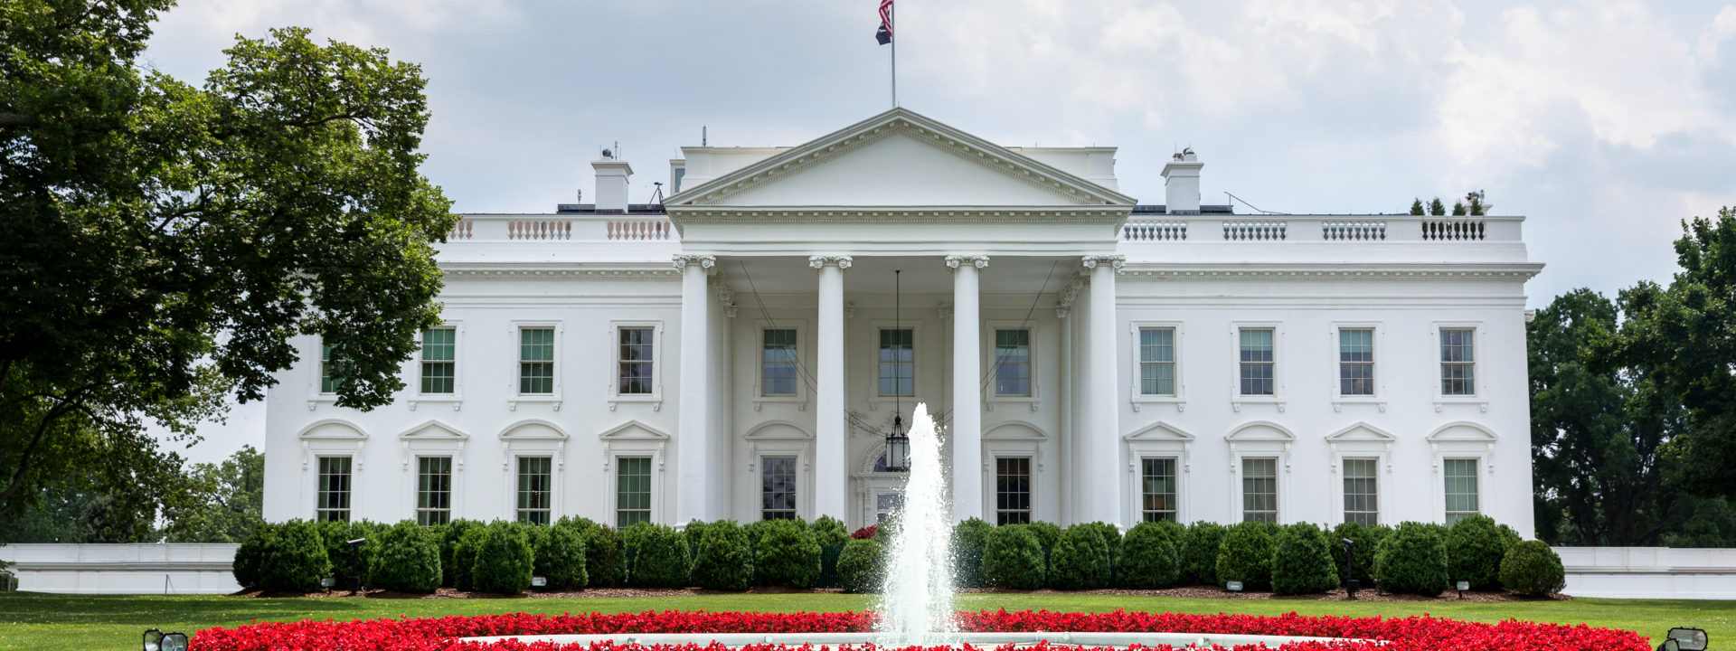
1. The White House
Open: 7 days a week, 7:30 am - 4 pm.
Duration: 1 hour to explore the video and exhibits. Focus: video (30 min), architecture, furnishings, first families, social events

Slide 4
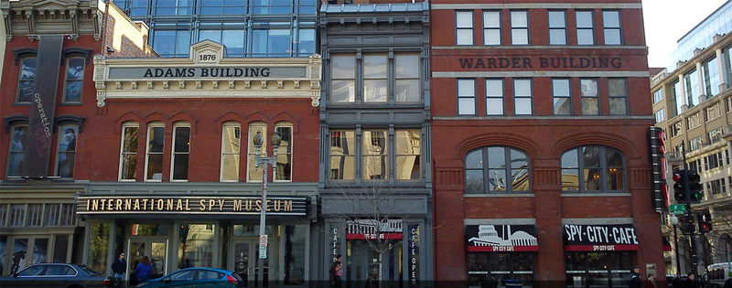
2. Spy Museum
Open: July 5 - August 25 9:00am - 7:00pm
Duration: 1 hour to explore the video and exhibits. Focus: the stories of individuals and their missions, tools, and techniques.

Slide 5
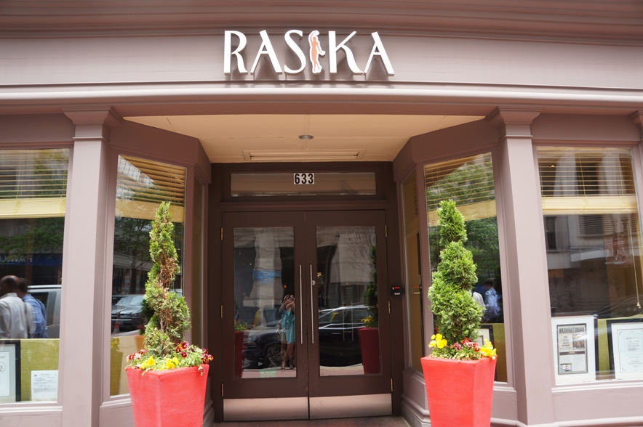
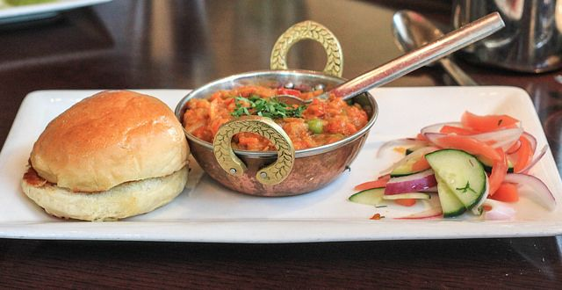
Lunch: RASIKA

Slide 6
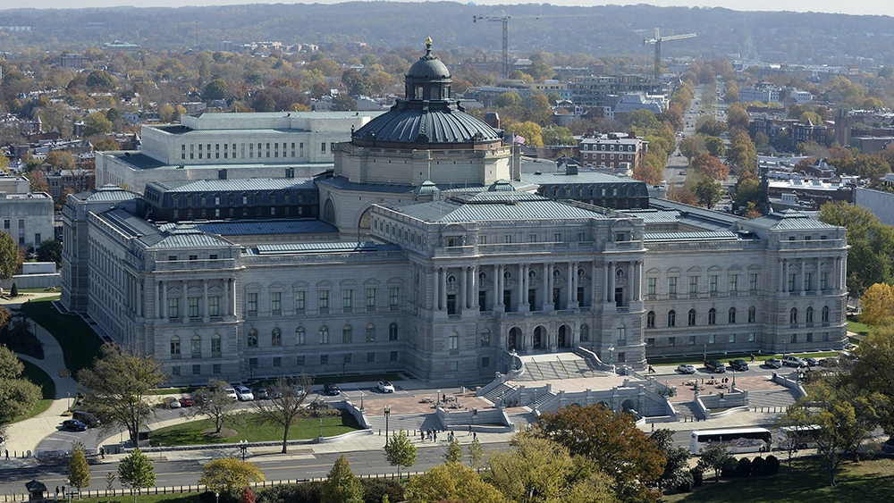
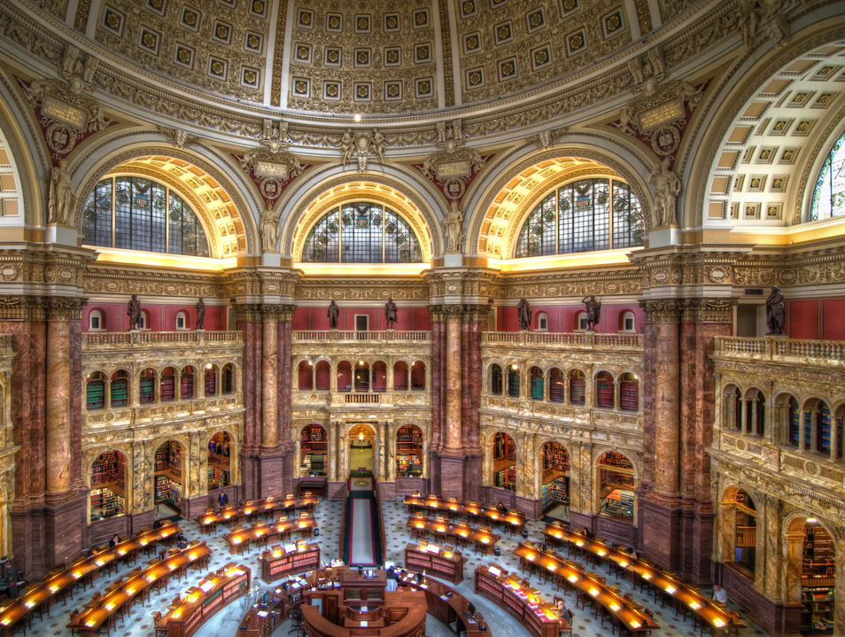
3: Library of Congress
Open: 7 days a week, 7:30 am - 4 pm.
Duration: 2 hour to explore the video and exhibits. Focus: video (30 min), architecture, furnishings, books

Slide 7
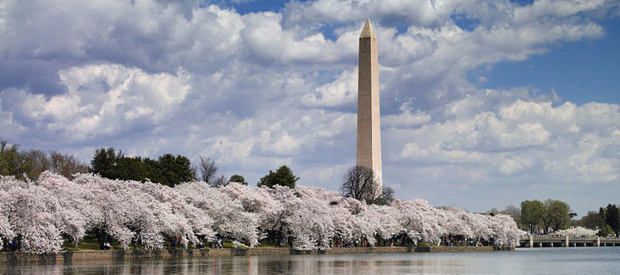
4: Washington Monument
Open: -- The Washington Monument is currently closed until spring 2019 for repairs
Duration: 30 minutes Focus: 555 feet tall

